Slide 1



WELCOME
HIGH CLOUD AIRLINES
PERMORMANCE ANALYSIS

Slide 2
HIGH CLOUD AIRLINES
PERMORMANCE ANALYSIS

Slide 3
1
INTRODUCTION AND SCOPE
Problem Statement
Data Overview
HIGH CLOUD AIRLINES
PERMORMANCE ANALYSIS

Slide 4
KPIs & PERFORMANCE ANALYSIS
Performance Trends
Segment-level insights
2
1
INTRODUCTION AND SCOPE
Problem Statement
Data Overview
HIGH CLOUD AIRLINES
PERMORMANCE ANALYSIS

Slide 5
KPIs & PERFORMANCE ANALYSIS
Performance Trends
Segment-level insights
3
KEY FINDINGS
Summary & Recommendations
2
1
INTRODUCTION AND SCOPE
Problem Statement
Data Overview
HIGH CLOUD AIRLINES
PERMORMANCE ANALYSIS

Slide 6
KPIs & PERFORMANCE ANALYSIS
Performance Trends
Segment-level insights
KEY FINDINGS
Summary & Recommendations
2
3
1
4
INTRODUCTION AND SCOPE
Problem Statement
Data Overview
CONCLUSION
Final Takeaways
Project overview
HIGH CLOUD AIRLINES
PERMORMANCE ANALYSIS

Slide 7
KPIs & PERFORMANCE ANALYSIS
Performance Trends
Segment-level insights
KEY FINDINGS
Summary & Recommendations
2
3
1
4
INTRODUCTION AND SCOPE
Problem Statement
Data Overview
CONCLUSION
Final Takeaways
Project overview
HIGH CLOUD AIRLINES
PERMORMANCE ANALYSIS

Slide 8
PROBLEM
STATEMENT
PROBLEM
STATEMENT
To identify trends and improvement areas in High Cloud Airlines’ seasonal patterns and segment level performance.
To identify trends and improvement areas in High Cloud Airlines’ seasonal patterns and segment level performance.

Slide 9
DATA OVERVIEW
PROBLEM
STATEMENT
The dataset contains flight operation records from 2008 to 2013 for High Cloud Airlines.
Total Records:
Over 1.1 lakh+ flight records are included.
Carrier Types:
Passenger Carrier, Mail Carrier, Freight Carrier
Key Dimensions:
Date (Year, Month, Quarter)
Geography (Source & Destination Country, State, City)
Distance Group: Classifies flights by travel range
Key Metrics:
Passenger Count, Available Seats, No. of Flights
To identify trends and improvement areas in High Cloud Airlines’ seasonal patterns and segment level performance.

Slide 10





DATA OVERVIEW
DATA
OVERVIEW
Operating Regions
No. of Flights
The dataset contains flight operation records from 2008 to 2013 for High Cloud Airlines.
Important Fields include:
Date (Year, Month, Quarter)
Carriers, Origin/Destination Country, State, City
Distance Travelled, Available seats, Transported Passengers etc.
Tools used:
MS Excel, Power Bi, Tableau, MySQL
6
110.8K
Available Seats
Total Passengers
243.5M
187M

Slide 11

WHAT IS LOAD FACTOR?
A KEY METRIC THAT INDICATES HOW WELL AN AIRLINE IS UTILIZING ITS CAPACITY
Load Factor increased from 2008 to 2011 (peak: 17.42%).
Slight dip in 2012, then stabilized in 2013.
Indicates improving demand alignment and planning
LOAD FACTOR
4/5
80%

Slide 12
PERFORMANCE ANALYSIS
LOAD FACTOR % BY YEAR
Load Factor increased from 2008 to 2011 (peak: 17.42%).
Slight dip in 2012, then stabilized in 2013.
Indicates improving demand alignment and planning

Slide 13
PERFORMANCE ANALYSIS
LOAD FACTOR % BY QUARTER
Load Factor increased from 2008 to 2011 (peak: 17.42%).
Slight dip in 2012, then stabilized in 2013.
Indicates improving demand alignment and planning
Load factor rises from January to peak in July (~9%).
Slight drop observed after August.
Seasonal trend: summer travel boosts load factor.
Q3 shows peak load factor, likely due to summer travel demand.
Q1 records the lowest efficiency, signaling need for seasonal interventions.

Slide 14
PERFORMANCE ANALYSIS
LOAD FACTOR % BY MONTH
Load factor rises from January to peak in July (~9%).
Slight drop observed after August.
Seasonal trend: summer travel boosts load factor.
Delta Airlines Inc
Southwest Airlines Co.
Continental Air Lines Inc.
US Airways Inc.
SkyWest Airlines Inc.
American Eagle Airlines
ExpressJet Airlines Inc.
Comair Inc.
Atlantic Southeast Airlines
Allegiant Air

Slide 15
PERFORMANCE ANALYSIS
LOAD FACTOR % BASED ON CARRIER NAME
Delta Airlines Inc
Southwest Airlines Co.
Continental Air Lines Inc.
US Airways Inc.
SkyWest Airlines Inc.
American Eagle Airlines
ExpressJet Airlines Inc.
Comair Inc.
Atlantic Southeast Airlines
Allegiant Air

Slide 16
PERFORMANCE ANALYSIS
LOAD FACTOR % BASED ON CARRIER NAME
Delta Airlines Inc
Delta Airlines leads (19.60%), closely followed by Southwest (18.92%).
Carriers like Comair, Atlantic Southeast, Allegiant Air Airlines contribute the least.
Load efficiency gap among carriers.
Southwest Airlines Co.
Continental Air Lines Inc.
US Airways Inc.
SkyWest Airlines Inc.
American Eagle Airlines
ExpressJet Airlines Inc.
Comair Inc.
Atlantic Southeast Airlines
Allegiant Air

Slide 17
PERFORMANCE ANALYSIS
TOP 10 CARRIERS BASED OF PASSENGERS PREFERENCE
Delta (8,271) and Southwest (8,019) dominate.
ExpressJet and FedEx also in the top 10.
Distribution shows presence of both commercial and logistics carriers..

Slide 18
PERFORMANCE ANALYSIS
TOP ROUTES BASED ON NUMBER OF FLIGHTS
Chicago–Detroit is the most travelled route (95 flights).
Washington DC and Atlanta are highly active hubs.
Strong presence of short-haul business corridors.

Slide 19
PERFORMANCE ANALYSIS
WEEKENDS VS WEEKDAYS LOAD FACTOR%
Weekdays contribute to 71.18% of total load factor.
Weekend travel accounts for only 28.82%.
Demand significantly skews towards weekday flights.

Slide 20
PERFORMANCE ANALYSIS
WEEKENDS VS WEEKDAYS LOAD FACTOR%
WEEKENDS
28.82%
Weekdays contribute to 71.18% of total load factor.
Weekend travel accounts for only 28.82%.
Demand significantly skews towards weekday flights.
WEEKDAYS
71.18%

Slide 21
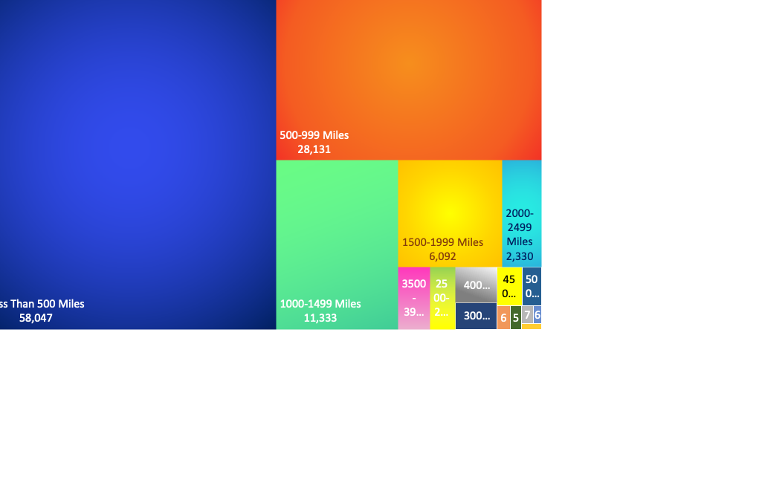
KEY INSIGHTS
SUMMARY OF ANALYTICAL RESULTS
PERFORMANCE ANALYSIS
NO. OF FLIGHTS BASED ON DISTANCE GROUP
Stable Yearly Efficiency
Short-Distance Flights Dominate
1
4
Overall Stable across years. Indicates consistent demand & operational balance
Over 53.5% of flights are under 500 miles.
500–999 mile range is the second most frequent.
Long-haul routes (1500+ miles) are very limited.
Over 80% of flights are < 1000 miles. Implies a regional hub-based model
Seasonality Impacts Load Factor
Weekday Travel Dominates
2
5
Heavy summer travel demand and off-peak challenges in winter.
71% of passengers prefer weekdays, highlighting business travel behavior over leisure-based weekend travel.
Uneven Load Factor Efficiency
3
6
Uneven Route Demand
Delta and Southwest alone make-up around 39%. while Comair and ExpressJet show underperformance
Heavy dependence on a few routes and a few carriers risks operational resilience if those face disruption.

Slide 22
KEY RECOMMENDATIONS
SUGGESTIONS TO IMPROVE PERFORMANCE
KEY INSIGHTS
SUMMARY OF ANALYTICAL RESULTS
Stable Yearly Efficiency
Short-Distance Flights Dominate
1
4
Overall Stable across years. Indicates consistent demand & operational balance
Over 80% of flights are < 1000 miles. Implies a regional hub-based model
Seasonality Impacts Load Factor
Weekday Travel Dominates
2
5
Heavy summer travel demand and off-peak challenges in winter.
71% of passengers prefer weekdays, highlighting business travel behavior over leisure-based weekend travel.
Uneven Load Factor Efficiency
3
6
Uneven Route Demand
Delta and Southwest alone make-up around 39%. while Comair, Allegiant etc. show underperformance
Heavy dependence on a few routes and a few carriers risks operational resilience if those face disruption.

Slide 23
KEY RECOMMENDATIONS
SUGGESTIONS TO IMPROVE PERFORMANCE
Q1 Load Factor Recovery
Optimize Route Planning
Seasonal campaigns, dynamic pricing, and reduced capacity on underperforming routes
Analyze demand patterns on key routes to cut waste and boost efficiency."
Stable Yearly Efficiency
Short-Distance Flights Dominate
1
4
Overall Stable across years. Indicates consistent demand & operational balance
Over 80% of flights are < 1000 miles. Implies a regional hub-based model
Seasonality Impacts Load Factor
Weekday Travel Dominates
2
5
Heavy summer travel demand and off-peak challenges in winter.
71% of passengers prefer weekdays, highlighting business travel behavior over leisure-based weekend travel.
Uneven Load Factor Efficiency
3
6
Uneven Route Demand
Delta and Southwest alone make-up around 39%. while Comair and ExpressJet show underperformance
Heavy dependence on a few routes and a few carriers risks operational resilience if those face disruption.
Boost Weekend Traffic
Focus on Top Carriers
Grow Long-Haul Network
Promote flexible fares, leisure packages, or loyalty incentives
Align more flights with Southwest & Delta, and reassess performance contracts with low-efficiency carriers.
Explore new city pairs in the 1000-2000+ mile range to diversify operations.

Slide 24
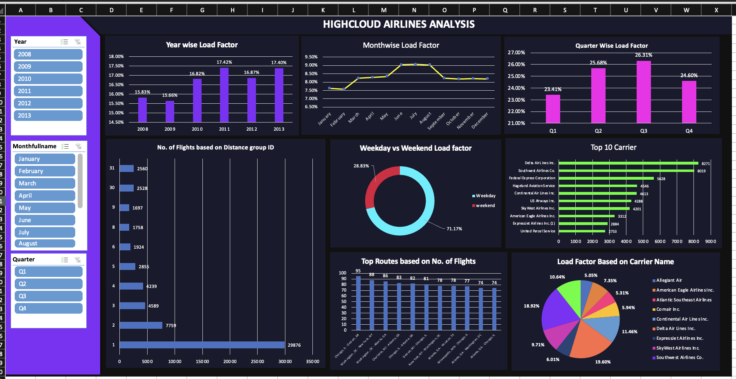
DASHBOARD
MS EXCEL

Slide 25
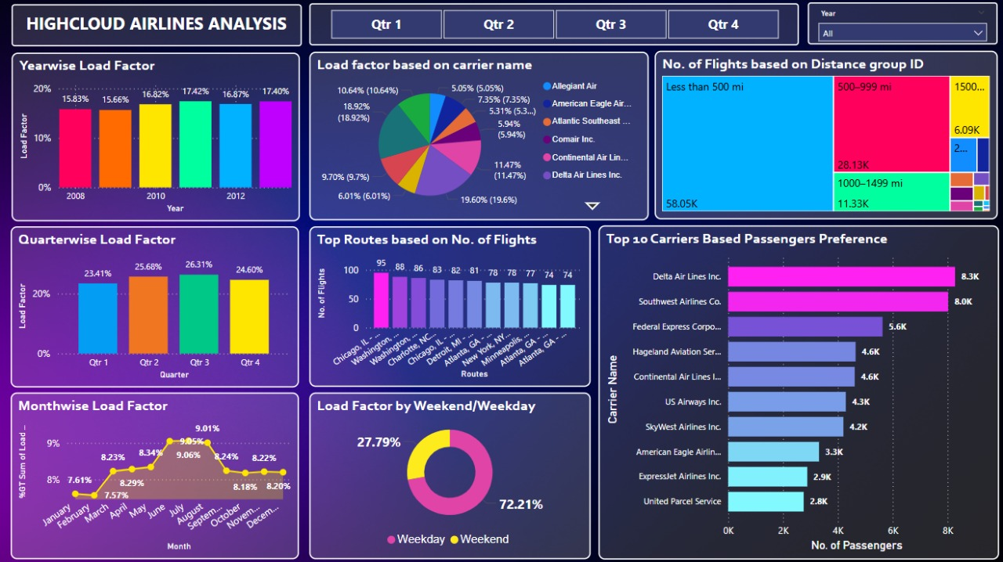
DASHBOARD
MS POWER BI

Slide 26
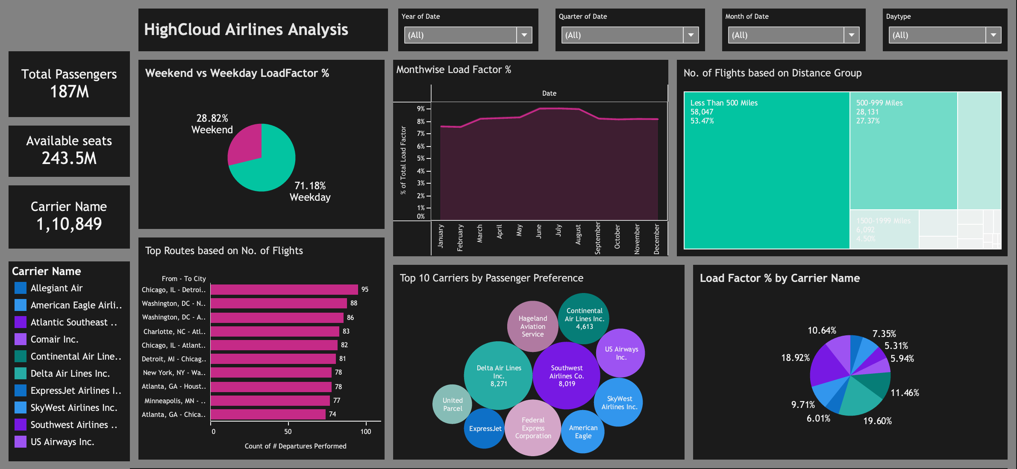
DASHBOARD
TABLEAU PUBLIC

Slide 27
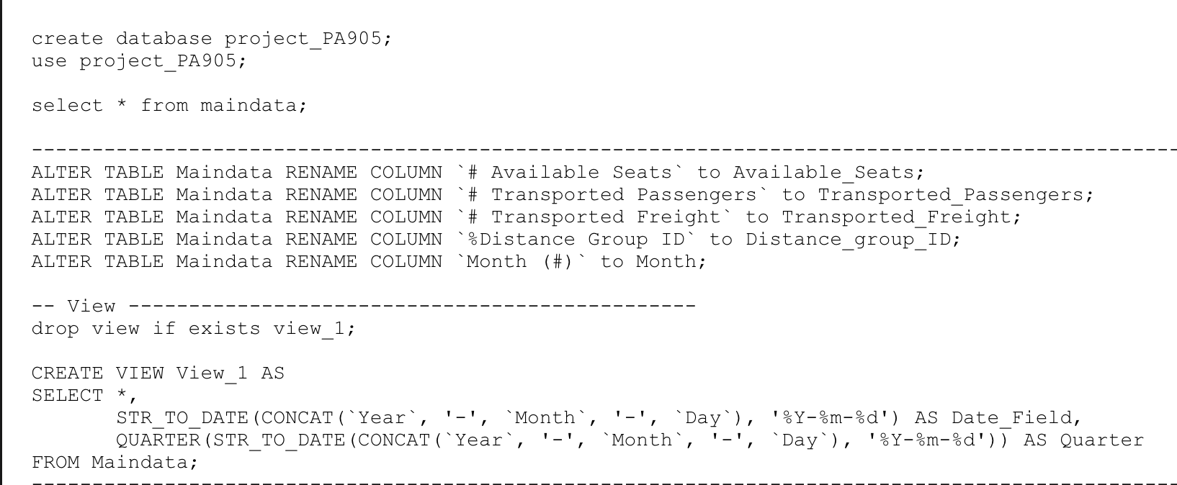
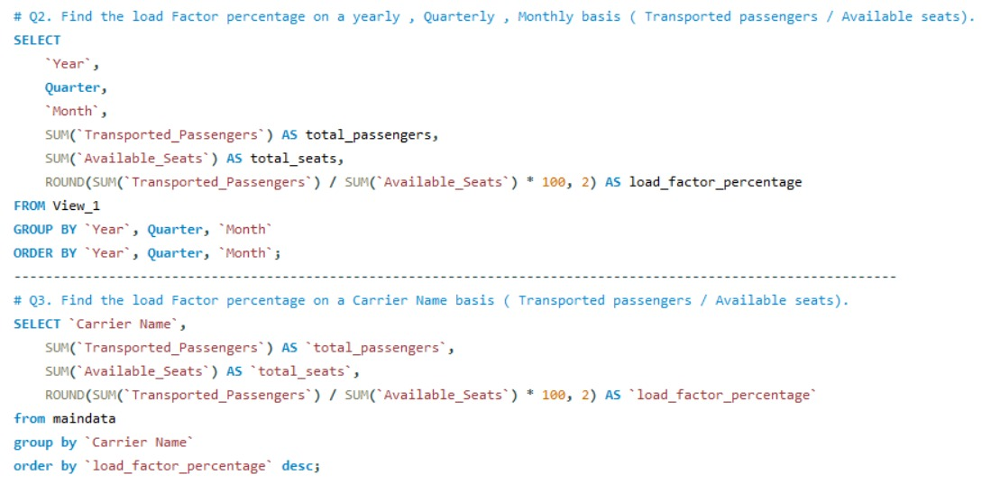
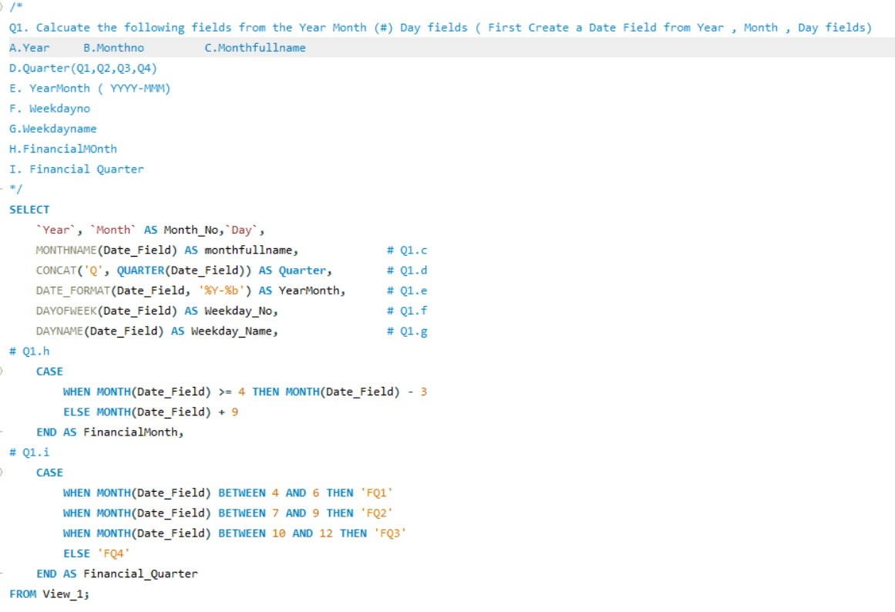
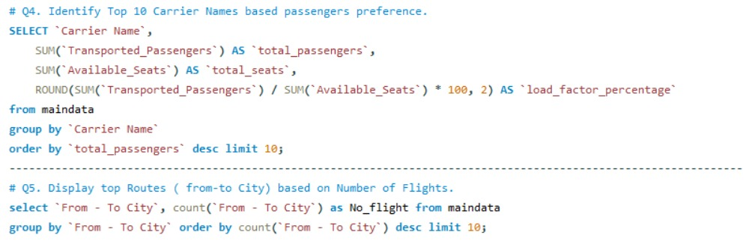
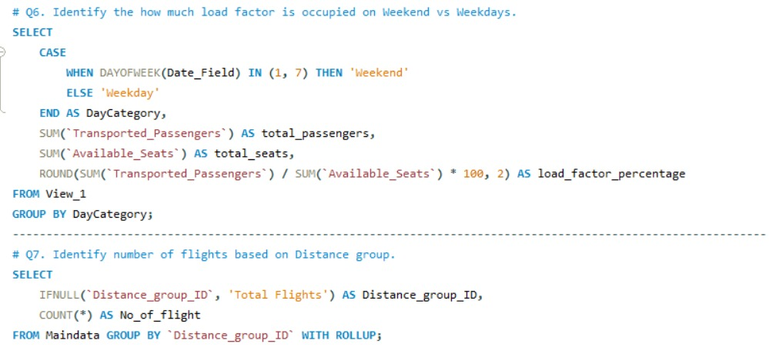
MY-SQL QUERIES
QUERY LOGIC USED FOR ANALYSIS

Slide 28
CONCLUSION
OVERALL SUMMARY AND REMARKS
ANALYZED OPERATIONAL FLIGHT DATA (2008–2013)
EVALUATED KEY KPIS AND PATTERNS
IDENTIFIED SEGMENT-LEVEL INSIGHTS
PROPOSED TARGETED RECOMMENDATIONS

Slide 29
THANK YOU

